Slide 1


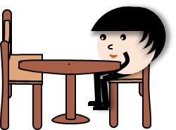

Slide 2



Slide 3
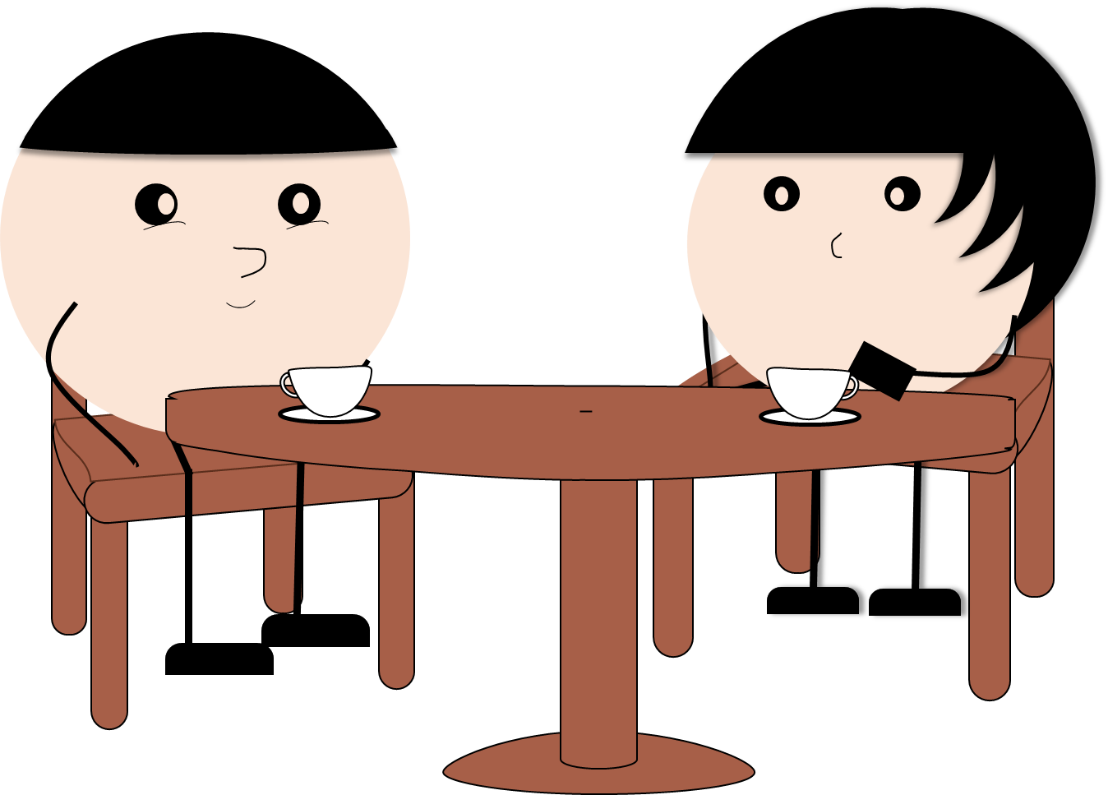

Slide 12

ALBUM

Slide 13
ALBUM

Slide 14
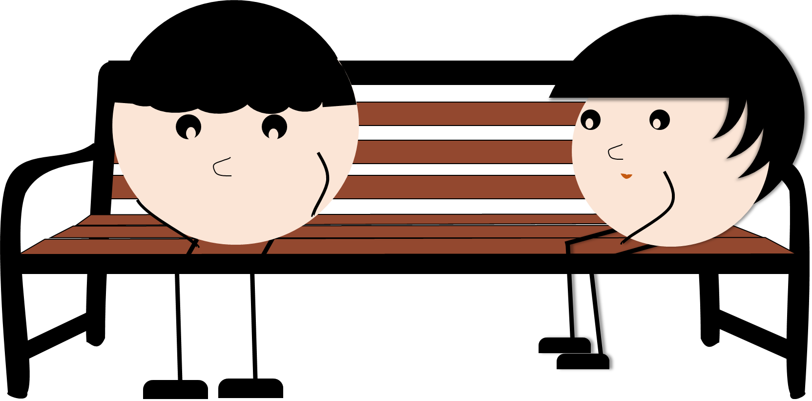

Slide 15
Unspoken Words
Full Episode

